Slide 1

Java Programming
Graphics
图形绘制

Slide 2
Why graphic programming?
This chapter shows you how you can paint your own custom drawing (such as graphs, charts, drawings and, in particular, computer game avatars) because you cannot find standard GUI components that meets your requirements.
Suggestion: you should try to reuse the standard or 3rd part GUI components as far as possible and leave custom graphics as the last resort.

Slide 3
Outline
Graphics
Colors
Fonts
Images
Animation
Timer
Tetris game
Using 3rd part library: JfreeChart

Slide 4
java.awt.Graphics
In Java, custom painting is done via the java.awt.Graphics class, which manages a graphics context, and provides a set of device-independent methods for drawing texts, figures and images on the screen on different platforms.
Note:
The java.awt.Graphics is an abstract class, as the actual act of drawing is system-dependent and device-dependent. Each operating platform will provide a subclass of Graphics to perform the actual drawing under the platform, but conform to the specification defined in Graphics.

Slide 5
Graphics Context(图形环境)
A graphics context provides the capabilities of drawing on the screen.
The graphics context maintains states such as the color and font used in drawing, as well as interacting with the underlying operating system to perform the drawing.

Slide 6
java.awt.Graphics
The Graphics class provides methods for drawing three types of graphical objects:
Text strings:
via the drawString() method. Take note that System.out.println() prints to the system console, not to the graphics screen.
Vector-graphic primitives and shapes:
via methods drawXxx() and fillXxx(), where Xxx could be Line, Rect, Oval, Arc, PolyLine, RoundRect, or 3DRect.
Bitmap images:
via the drawImage() method.

Slide 7
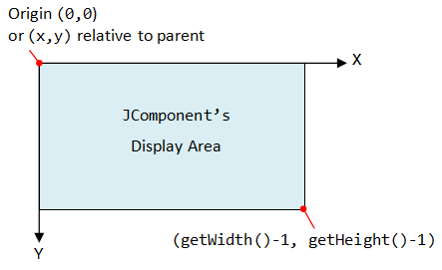
Graphics Coordinate System(坐标系统)
In Java Windowing Subsystem (like most of the 2D Graphics systems), the origin (0,0) is located at the top-left corner.
EACH component/container has its own coordinate system, ranging for (0,0) to (width-1, height-1) as illustrated.
You can use method getWidth() and getHeight() to retrieve the width and height of a component/container. You can use getX() or getY() to get the top-left corner (x,y) of this component's origin relative to its parent.

Slide 8
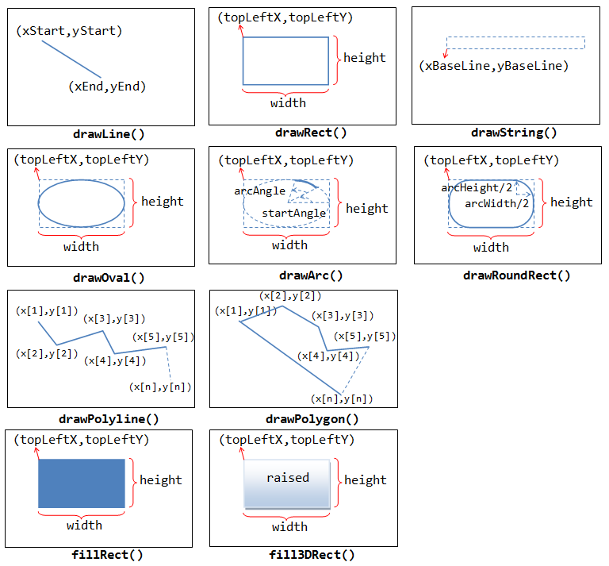
java.awt.Graphics

Slide 9

Custom painting – Drawing Mickey
Under Swing, custom painting is usually performed by extending a JPanel as the drawing canvas and override the paintComponent(Graphics g) method to perform your own drawing with the drawing methods provided by the Graphics class.
For example, we want to draw a Mickey.

Slide 10
Getting canvas
The extended JPanel is often programmed as an inner class of a JFrame application to facilitate access of private variables/methods.
Although we typically draw on the JPanel, you can in fact draw on any JComponent (such as JLabel, JButton).
JFrame
Graphics
Jpanel

Slide 11
Drawing Mickey
private class DrawMickey extends JPanel {
@Override
public void paintComponent(Graphics g) {
super.paintComponent(g);
Rectangle rec = new Rectangle(100, 100, 100, 100);
drawMickey(g, rec);
}
private void drawMickey(Graphics g, Rectangle bb) {…}
private void boxOval(Graphics g, Rectangle bb) {…}
}
@See: http://docs.oracle.com/javase/7/docs/api/java/awt/Rectangle.html

Slide 12
Drawing Mickey
public void drawMickey(Graphics g, Rectangle bb) {
boxOval(g, bb);
int dx = bb.width / 2;
int dy = bb.height / 2;
Rectangle half = new Rectangle(bb.x, bb.y, dx, dy);
half.translate(-dx / 2, -dy / 2);
boxOval(g, half);
half.translate(dx * 2, 0);
boxOval(g, half);
}
public void boxOval(Graphics g, Rectangle bb) {
g.fillOval(bb.x, bb.y, bb.width, bb.height);
}

Slide 13
public class Mickey extends JFrame {
public Mickey() {
setTitle("Mickey");
setDefaultCloseOperation(JFrame.EXIT_ON_CLOSE);
setBounds(100, 100, 315, 315);
Container cp = getContentPane();
DrawMickey canvas = new DrawMickey(); // Construct the drawing canvas
cp.add(canvas);
setVisible(true);
}
public static void main(String[] args) {
EventQueue.invokeLater(new Runnable() {
public void run() {
try {
Mickey frame = new Mickey();
} catch (Exception e) {
e.printStackTrace();
}
}
});
}

Slide 14
Coloring Mickey
The graphic context maintains states (or attributes) such as the current painting color, the current font for drawing text strings, and the current painting rectangular area (called clip).
You can use the methods getColor(), setColor(), getFont(), setFont(), getClipBounds(), setClip() to get or set the color, font, and clip area. Any painting outside the clip area is ignored.

Slide 15
Colors
Set or get Graphics context's current color.
void setColor(Color c)
Color getColor()
The class java.awt.Color provides 13 standard colors as named-constants. They are:
RED, GREEN, BLUE, MAGENTA, CYAN, YELLOW, BLACK, WHITE, GRAY, DARK_GRAY, LIGHT_GRAY, ORANGE, and PINK.
You can use the toString() to print the RGB values of these color (e.g., System.out.println(Color.RED)):
RED : java.awt.Color[r=255, g=0, b=0]

Slide 16
Colors
You can also use the RGB values or RGBA value (A for alpha to specify transparency/opaque) to construct your own color via constructors:
Color(int r, int g, int b); // between 0 and 255
Color(int r, int g, int b, int alpha); // between 0 and 255
Color(float r, float g, float b); // between 0.0f and 1.0f
Color(float r, float g, float b, float alpha); // between 0.0f and 1.0f
For example:
Color myColor1 = new Color(123, 111, 222);
Color myColor2 = new Color(0.5f, 0.3f, 0.1f);
Color myColor3 = new Color(0.5f, 0.3f, 0.1f, 0.5f); //semi-transparent

Slide 17
Fonts
The class java.awt.Font represents a specific font face name, which can be used for rendering texts. You can use the following constructor to construct a Font instance:
public Font(String name, int style, int size);
name:
String constants Font.DIALOG, Font.DIALOG_INPUT, Font.MONOSPACED, Font.SERIF, Font.SANS_SERIF (JDK 1.6)
style:
String constants Font.PLAIN, Font.BOLD, Font.ITALIC or Font.BOLD|Font.ITALIC (Bit-OR)
size:
the point size of the font (in pt) (1 inch has 72 pt).

Slide 18
Fonts
The font family name(字体名称) is the name of the font family that determines the typographic design, like "Arial".
A font could have many style (字体样式), e.g., plain, bold or italic.
The font size(字体大小) is the size of the fonts.

Slide 19
Fonts
You can use the setFont() method to set the current font for the Graphics context g for rendering texts. For example,
Font myFont1 = new Font( Font.MONOSPACED, Font.PLAIN, 12);
Font myFont2 = new Font(Font.SERIF, Font.BOLD | Font.ITALIC, 16); JButton btn = new JButton("RESET");
btn.setFont(myFont1);
JLabel lbl = new JLabel("Hello");
lbl.setFont(myFont2);
Font myFont3 = new Font(Font.SANS_SERIF, Font.ITALIC, 12);
g.setFont(myFont3);
g.drawString("Using the font set", 10, 50); // using myFont3

Slide 20
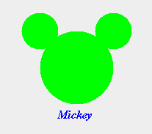
Coloring & Naming Mickey
private void drawMickey(Graphics g, Rectangle bb) {
g.setColor(Color.GREEN);
boxOval(g, bb);
int dx = bb.width / 2;
int dy = bb.height / 2;
Rectangle half = new Rectangle(bb.x, bb.y, dx, dy);
half.translate(-dx / 2, -dy / 2);
boxOval(g, half);
half.translate(dx * 2, 0);
boxOval(g, half);
g.setColor(Color.BLUE);
g.setFont(new Font(Font.SERIF, Font.BOLD | Font.ITALIC, 16));
g.drawString("Mickey", bb.x+25, bb.y+120);
}

Slide 21
Moving Mickey
At times, we need to explicitly refresh the display (e.g., in game and animation). We shall NOT invoke paintComponent(Graphics) directly.
Instead, we invoke the JComponent's repaint() method. The Windowing Subsystem will in turn call back the paintComponent() with the current Graphics context and execute it in the event-dispatching thread for thread safety.
You can repaint() a particular JComponent (such as a JPanel) or the entire JFrame. The children contained within the JComponent will also be repainted.

Slide 22
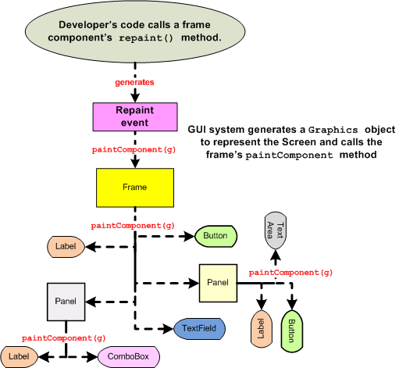
The repaint() method

Slide 23
addKeyListener(new KeyAdapter() {
@Override
public void keyPressed(KeyEvent evt) {
switch (evt.getKeyCode()) {
case KeyEvent.VK_LEFT:
x -= 10;
break;
case KeyEvent.VK_RIGHT:
x += 10;
break;
case KeyEvent.VK_UP:
y -= 10;
break;
case KeyEvent.VK_DOWN:
y += 10;
break;
}
repaint();
}
});

Slide 24
Demo

Slide 25
Animation(动画)
Creating an animation (such as a bouncing ball) requires repeatedly running an updating task at a regular interval.
Swing provides a javax.swing.Timer class which can be used to fire ActionEvent to its registered ActionListeners at regular interval.

Slide 26
Timer(定时器)
The Timer class has one constructor:
public Timer(int delay, ActionListener listener)
You are required to override the actionPerformed() method of the ActionListener to specify your task's behavior.
The Timer fires an ActionEvent to the ActionListener after the (initial) delay, and then at regular interval after delay.

Slide 27
Timer
You can start and stop the Timer via the Timer's start() and stop() methods. For example,
int delay = 500; // milliseconds
//Create an instance of an anonymous subclass of ActionListener
ActionListener updateTask = new ActionListener() {
@Override
public void actionPerformed(ActionEvent evt) {
// ......
}
};
// Start and run the task at regular delay
new Timer(delay, updateTask).start();

Slide 28
Timer
A Timer can fire the ActionEvent to more than one ActionListeners. You can register more ActionListeners via the addActionListener() method.
The actionPerformed() runs on the event-dispatching thread, just like all the event handlers. You can be relieved of the multi-threading issues.

Slide 29
Moving Mickey by timer
ActionListener MickeyActionListener = new ActionListener(){
boolean xx=true,yy=true;
@Override
public void actionPerformed(ActionEvent arg0) {
if (x<30) xx=false;
if (y<10) yy=false;
if (y>getHeight()-120) yy=true;
if (x>getWidth()-100) xx=true;
if(xx) x-=10;else x+=10;
if(yy) y -= 10;else y+=10;
repaint();
}
};
new Timer(50, MickeyActionListener).start();

Slide 30

Tetris game
How to draw the map and Tetriminos?

Slide 31
The Tetrimino class
class Tetrimino extends JPanel implements KeyListener {
private static final long serialVersionUID = 1L;
Random ran = new Random();
public int TetriminoType;
public int score = 0;
public int rotateState;
public int x,y;
public int nextb = ran.nextInt(7);
public int nextt = ran.nextInt(4);
int[][] map = new int[13][23];
Tetrimino() {
newTetrimino();
newMap();
}
…
}

Slide 32
Draw the map and stopped squares
public void paintComponent(Graphics g) {
super.paintComponent(g);
// draw the map and stopped squares
for (j = 0; j < 22; j++) {
for (i = 0; i < 12; i++) {
if (map[i][j] == 2) { //draw walls
g.setColor(Color.BLACK);
g.fill3DRect(i * 20, j * 20, 20, 20, true);
}
if (map[i][j] == 1) { // draw squares stopped
g.setColor(Color.GREEN);
g.fill3DRect(i * 20, j * 20, 20, 20, true);
}
}
}
//draw the Tetrimino
…
}

Slide 33
Draw the Tetrimino
for (j = 0; j < 16; j++) {
if (shapes[blockType][turnState][j] == 1) {
g.setColor(Color.BLUE);
g.fill3DRect((j % 4 + x + 1) * 20, (j / 4 + y) * 20, 20, 20, true);
}
}

Slide 34
Move the Tetrimino by keyboard
public void keyPressed(KeyEvent e) {
switch (e.getKeyCode()) {
case KeyEvent.VK_DOWN:
fall();
break;
case KeyEvent.VK_UP:
rotate();
break;
case KeyEvent.VK_RIGHT:
right();
break;
case KeyEvent.VK_LEFT:
left();
break;
default:
break;
}
repaint();
}

Slide 35
Move the Tetrimino by timer
class TimerListener implements ActionListener {
public void actionPerformed(ActionEvent e) {
fall();
if (collisionDetect(x, y + 1, TetriminoType, rotateState)) {
addToMap(x, y, TetriminoType, rotateState);
clearLines();
newTetrimino();
}
repaint();
}
}

Slide 36
Drawing Bar Chart
Using 3rd part library: JfreeChart

Slide 37
JFreeChart
JFreeChart is a free 100% Java chart library that makes it easy for developers to display professional quality charts in their applications.
Before using JFreechart, we need to download it
JFreeChart
And following jars must be in the class path
jfreechart-1.0.13.jar
jcommon-1.0.16.jar
Reading materials:
http://www.javatips.net/blog/create-bar-chart-using-jfreechart

Slide 38
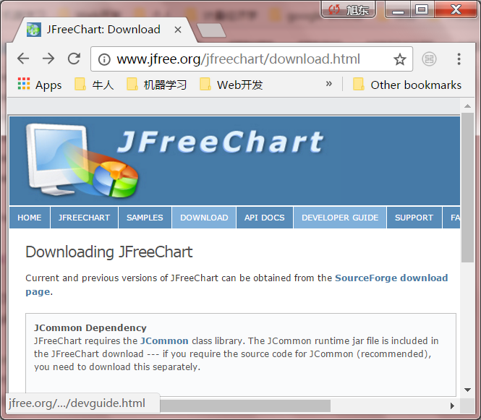
Downloading the JFreeChart
http://www.jfree.org/jfreechart/download.html

Slide 39
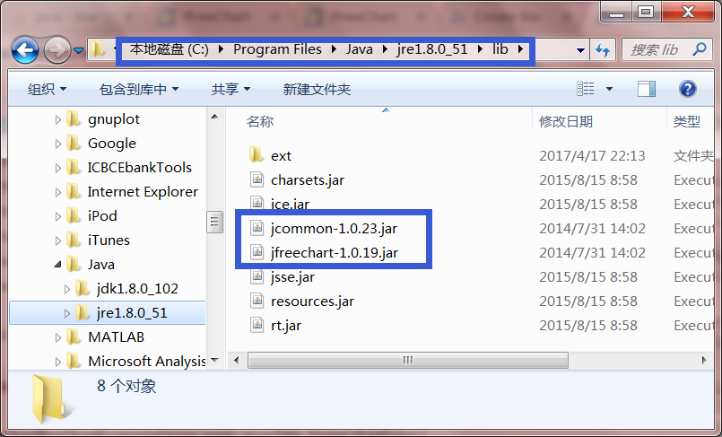
Copying jars into classpath

Slide 40
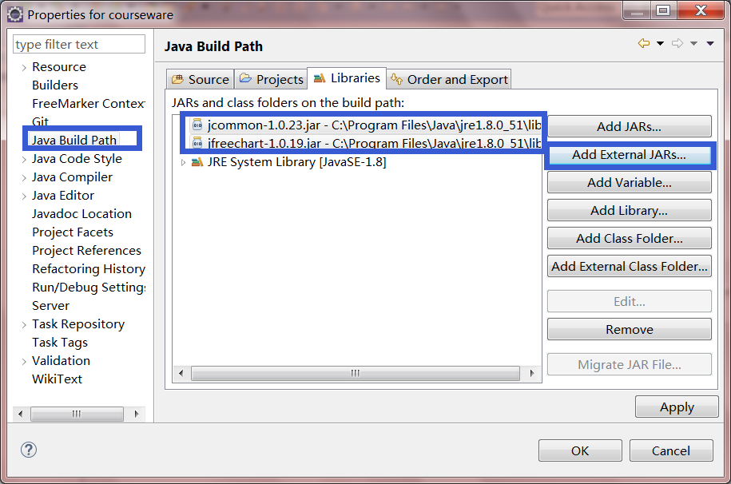
Adding jars into the build path

Slide 41
Example: drawing bar chart
public class TestXYBarChart {
public static IntervalXYDataset createDataset() {
XYSeriesCollection seriesCollection = new XYSeriesCollection();
XYSeries series1 = new XYSeries("BMI Statistics");
series1.add(1, 1);
series1.add(2, 2);
series1.add(3, 2);
series1.add(4, 7);
series1.add(5, 12);
series1.add(6, 16);
series1.add(7, 7);
series1.add(8, 3);
series1.add(9, 2);
series1.add(10, 1);
seriesCollection.addSeries(series1);
return new XYBarDataset(seriesCollection, 0.9);
}
public static void main(String[] args) {…}
}

Slide 42
Example: drawing bar chart
public static void main(String[] args) {
JFreeChart chart = ChartFactory.createXYBarChart("BMI Statistics",
"Intervals", false, "Number of Students",
createDataset(), PlotOrientation.VERTICAL,
true, false, false);
ChartFrame frame = new ChartFrame("BMI Statistics", chart);
frame.pack();
frame.setVisible(true);
}

Slide 43
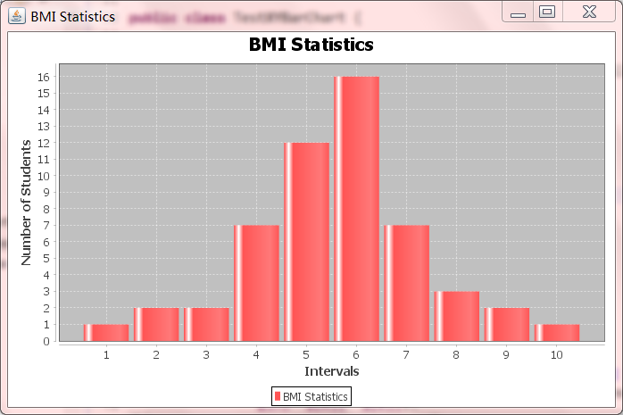
Example: drawing bar chart

Slide 44


